Slide 1
DATA SCIENCE
11 WEEK PART TIME COURSE
Week 5 - Dimensionality Reduction
Wednesday 27th April 2016

Slide 2
AGENDA
What is Dimensionality Reduction?
Why reduce dimensions?
What is Principal Component Analysis?
Lab
Real World Example
Discussion

Slide 3
DIMENSIONALITY REDUCTION
DATA SCIENCE PART TIME COURSE

Slide 4
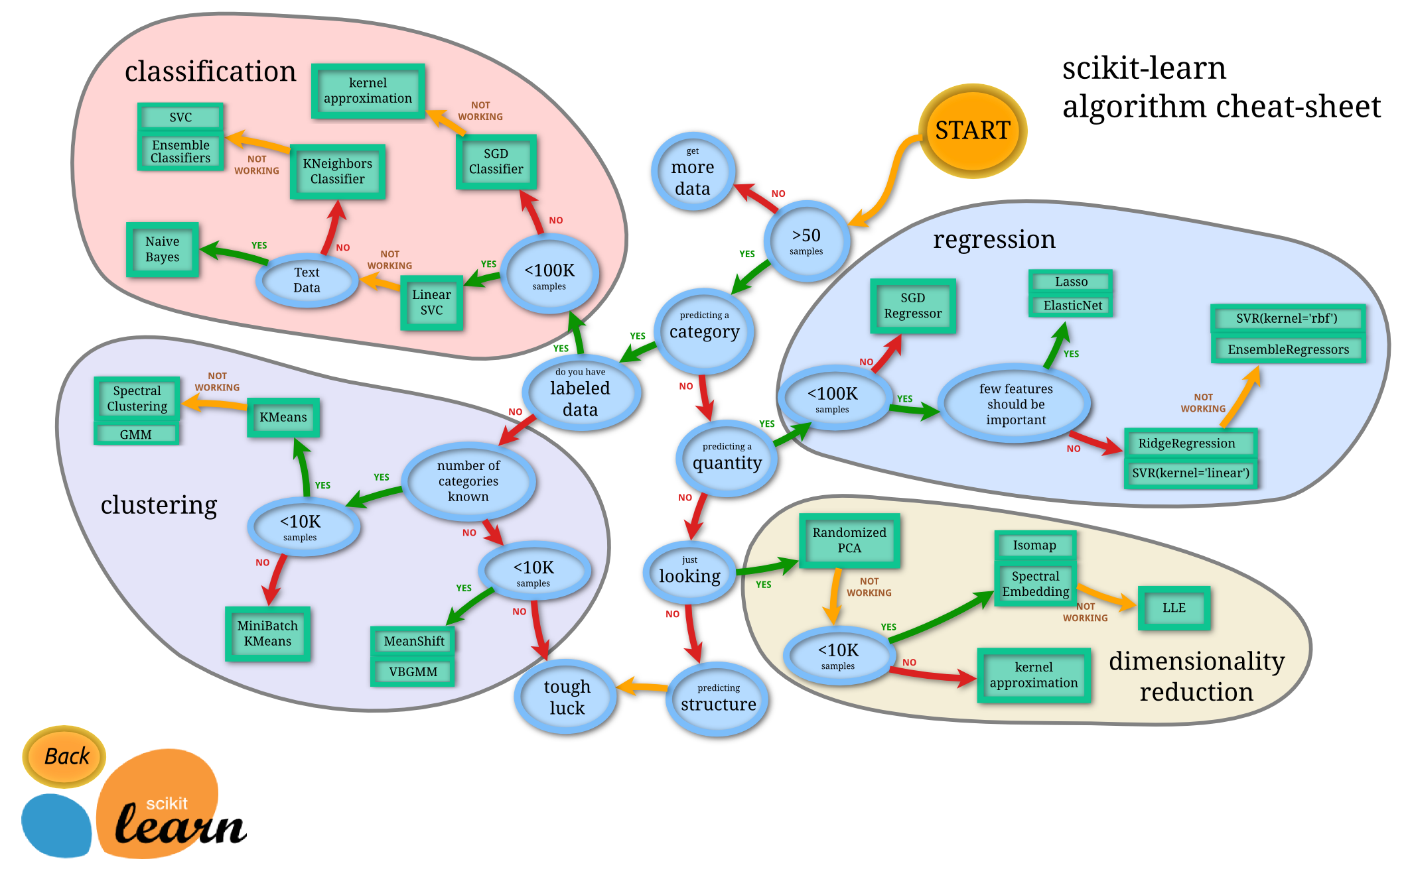

Slide 5

DIMENSIONALITY REDUCTION
A set of techniques for reducing the size (in terms of features,
records, and/or bytes) of the dataset under examination.
In general, the idea is to regard the dataset as a matrix and to decompose the matrix into simpler, meaningful pieces.

Slide 6
DIMENSIONALITY REDUCTION - WHY?
The number of features in our dataset can be difficult to manage, or even misleading (eg, if the relationships are actually simpler than they appear).
Ideally, we would like to eliminate redundancy and consolidate the number of variables we’re looking at.
The complexity that comes with a large number of features is due in part to the curse of dimensionality.

Slide 7
CURSE OF DIMENSIONALITY
The complexity that comes with a large number of features is due in part to the curse of dimensionality.
Namely, the sample size needed to accurately estimate a random variable taking values in a d-dimensional feature space grows exponentially with d (almost).
(More precisely, the sample size grows exponentially with l ≤ d, the dimension of the manifold embedded in the feature space).

Slide 8
GOALS OF DIMENSIONALITY REDUCTION
We’d like to analyze the data using the most meaningful basis (or coordinates) possible.
More precisely: given an n x d matrix X (encoding n observations of a d-dimensional random variable), we want to find a k-dimensional representation of X (k < d) that captures the information in the original data, according to some criterion.

Slide 9
PRINCIPAL COMPONENTS
DATA SCIENCE PART TIME COURSE

Slide 10
PRINCIPAL COMPONENTS
‘It finds a low-dimensional representation of a data set that contains as much as possible of the variation. The idea is that each of the n observations lives in p-dimensional space, but not all of these dimensions are equally interesting. PCA seeks a small number of dimensions that are as interesting as possible, where the concept of interesting is measured by the amount that the observations vary along each dimension. Each of the dimensions found by PCA is a linear combination of the p features.’
- Introduction to Statistical Learning

Slide 11
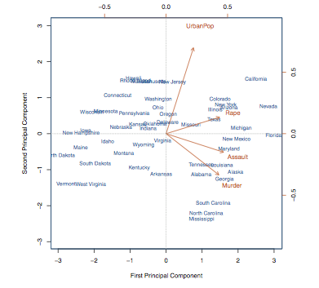

Slide 12
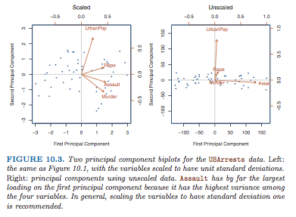

Slide 13
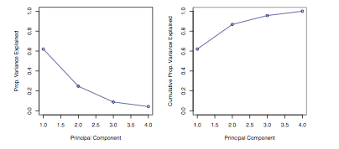

Slide 14

LAB
DATA SCIENCE PART TIME COURSE

Slide 15

SYNCHING A FORK
git remote -v
git remote add upstream https://github.com/ihansel/SYD_DAT_3.git
git remote -v
git fetch upstream
git checkout master
git merge upstream/master
OR git reset --hard upstream/master

Slide 16
DISCUSSION TIME
Real Problems
Homework & Readings
Project & Hackday
(Another) Survey
DATA SCIENCE - Week 6 Day 1

Slide 17


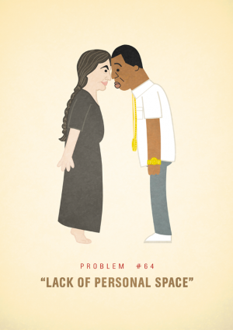
REAL PROBLEMS
DATA SCIENCE - Week 6 Day 1

Slide 18
HOMEWORK
Two Parts
Part 1: Pick one data science topic that interests you, could be an article, or how a Kaggle competition was won, or an article incorporating data journalism. Write a 5 minute presentation with 5 slides. You should explain, what was done, the motivation behind it, the results and what you can think of that would improve the project.
Part 2: Project work
DATA SCIENCE - Week 6 Day 1

Slide 19
Readings
Read the following
Chapter 8 of Introduction to Statistical Learning, Tree Based Methods (30 pages)
DATA SCIENCE - Week 6 Day 1

Slide 20
Project
I will be checking progress over the weekend and making some recommendations and asking questions.
Have most recent progress up on github by Saturday
Hackday
Opportunity to work on project, cover any material you want to review, & maybe a few bonus topics ?????
Who’s (really) keen ?
When suits everyone ?
Saturday 7th May 2016
DATA SCIENCE - Week 6 Day 1

Slide 21
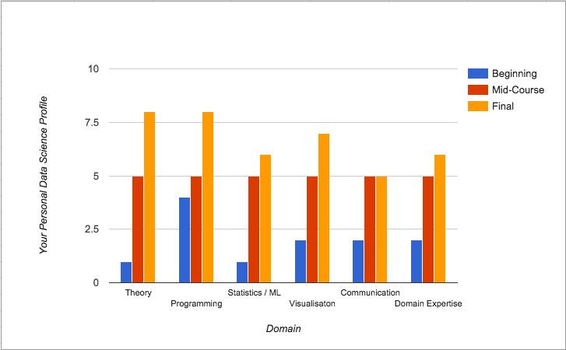
CONTENT PHILOSOPHY

